Slide 1
Introducing Rungway
Connecting GDST sixth formers with our alumnae network

Slide 2
GDST is a family of 25 girls’ schools.
You, me, us, we are stronger together.
Notes:
You’re a sixth former at XXX, but being part of the GDST means you’re also part of something bigger- learning, discovering alongside 19,000 other students in our family of schools.

Slide 3
Our network is our superpower.
A family of 25 schools and the largest women’s network of its kind in the world.
Notes:
And it’s not just a family of students you’ve joined.
Our network is our superpower. And when we’re talking about our network, yes we’re thinking about our current students but we’re also thinking about our amazing alumnae community. A network of over 70,000 women worldwide, making it the biggest network of its kind. Our alumnae come from all walks of life and when we say “in all walks of life”, we mean it. Whatever path you’re thinking of taking now, the chances are, someone from a GDST school will have already walked it – so you’ll never be alone and you’ll have a support network available to help you.

Slide 4
GDST Alumnae
Hannah Reid
CEO and founder of Coding Black Females.
Nottingham Girls’ High School
Ramita Navai
Dr Ellie Cannon
Founder of Looby Lou’s Lovely Lunches
Birkenhead High School Academy
Lead Singer of London Grammar.
Notting Hill and Ealing High School
Charlene Hunter MBE
NHS Doctor, broadcaster and health writer.
Newcastle High School for Girls
Louisa Blake
Multi-award winning Journalist.
Putney High School
Notes:
Who are some of our alumnae?

Slide 5
Your school alumnae
Notes:
Schools may wish to add in some of their alumnae here to familiarise students with their network and offer some insights into role models from their own school.
Ideas: https://www.gdst.net/alumnae/notable-alumnae/ or https://www.gdst.net/aoya-2023/
Alumnae by school: https://docs.google.com/spreadsheets/d/1m8UkwOt7aZpgQT8kVcRboo0lCbO4q2p6/edit?usp=sharing&ouid=101169173672803211220&rtpof=true&sd=true

Slide 6
What is Rungway?
GDST Rungway
Rungway is the GDST’s mentoring app where every sixth former can connect with our GDST family to ask key questions you have.
Rungway is available on demand, offering personalised advice from not just one expert but drawing on the expertise of many women.
Notes:
Rungway provides on-demand mentoring for GDST sixth formers, tapping into the expertise and skills of our wonderful alumnae mentors.

Slide 7
How can Rungway help me?
GDST Rungway
Through Rungway, you can get the answers you need – from hundreds of mentors who have experience and expertise to share – on any questions you have about life, careers or study.
Rungway offers quick, flexible advice without having to commit to formal long-term mentoring relationship.
Notes:
You can get advice from more than one alumna too, and decide for yourself which is most helpful.

Slide 8
What kind of questions could I ask?
GDST RUGWAY
Does anyone have any tips for the UCAT? For example, how to improve speed in quantitative reasoning
“Should I choose uni by course or institution?”
“What is the key skill you look for in the finance sector?”
I am a year 12 student and am finding it difficult to get any work done. I almost feel like I've lost my love for the subjects and I just don’t know what to do. Any advice or tips ?
“Is work life balance a myth?
Does anyone know of any Computer Science degree apprenticeships?
Notes:
Specific questions get more responses in general.
'Where is a good place to study law?' Is too big a question to answer, and can also be researched elsewhere.
"Does anyone have any feedback on the law course at Cambridge?" Or "what did you find most enjoyable/surprising/difficult about your law degree" are more likely to get a good response.

Slide 9
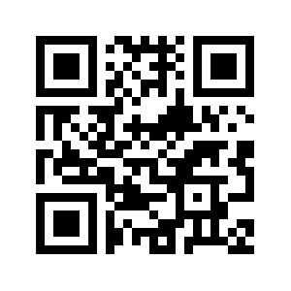
Joining the Community
Gdst rungway
Go to:
https://app.rungway.com/login
For quick access on your phone download the Rungway App from Google Play or the Apple App store

Slide 10
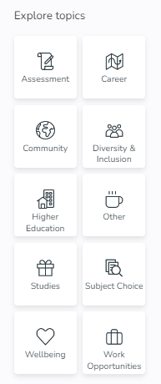
Making Rungway work for you
GDST RUNGWAY
Check in regularly
Start open conversations, and join in others
Use the reaction buttons to express your opinions on a post
Use the topics to explore areas which interest you the most (your question might already have been asked with useful responses)

Slide 11
Any Questions?
Notes:
Any questions or comments?

